Slide 1
Fundamentals of Project Management
MS(PM) MSP 601 Semester: 1 Fall 2024
Lecture # 3
FACULTY OF MANAGEMENT STUDIES - BUKC

Slide 2
WHAT IS A PROJECT?
What Do you mean by Temporary Endeavor?
Does Temporary Endeavor mean short term in duration?
How can be the purpose to end the project?
What do you call unique result, product and service?
And what is it?
Can elements with a project can b repeated? Eg?
Can 2 building of exactly same design cost size b still unique?
How?
If I say Project enhance Business Value for project? What is BV & How?
What is the importance of Project Management

Slide 3
Learning Outcomes for Lecture #3
Organizational influences and project lifecycle:
Organizational influences on project management
Project stakeholders and governance
Project lifecycle
The Project Manager
Drivers of project management

Slide 4
PROJECTS ENVIRONMENT
Projects environment influence their operation; favorable or unfavorable.
Two major categories are:
Enterprise Environmental Factors (EEFs)
Organizational Process Assets (OPAs).
EEFs originate inside/outside the project and the enterprise. Impact at the organizational, portfolio, program, or project level.
OPAs arise from the organization itself, a portfolio, a program, another project, or a combination of these.

Slide 5
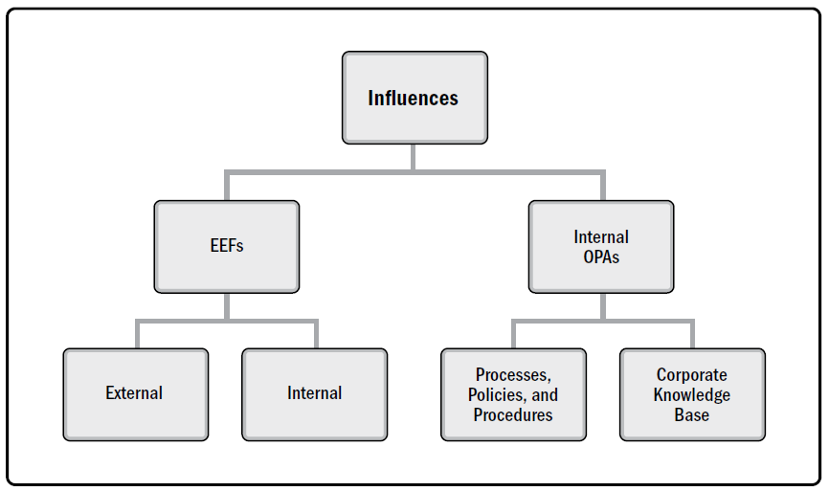
PROJECT INFLUENCES

Slide 6
ENTERPRISE ENVIRONMENTAL FACTORS
EEFs refer to conditions, not under the control of the project team, that influence, constrain, or direct the project.
EEFs are considered as inputs, for most planning processes.
May enhance or constrain project management options.
May have a positive or negative influence on the outcome.
Vary widely in type or nature.
These factors need to be considered if the project is to be effective.

Slide 7
EEFS INTERNAL TO THE ORGANIZATION
Organizational culture, structure, and governance. Vision, mission, values, beliefs, cultural norms, leadership style, hierarchy and authority relationships, organizational style, ethics, and code of conduct.
Geographic distribution of facilities and resources. Factory locations, virtual teams, shared systems, and cloud computing.
Infrastructure. Existing facilities, equipment, organizational telecommunications channels, IT hardware, availability, and capacity.

Slide 8
EEFS INTERNAL TO THE ORGANIZATION
IT software. scheduling software tools, configuration management systems, web interfaces to other online automated systems, and work authorization systems.
Resource availability. contracting and purchasing constraints, approved providers, subcontractors, and collaboration agreements.
Employee capability. Existing HR expertise, skills, competencies, and specialized knowledge.

Slide 9
EEFS EXTERNAL TO THE ORGANIZATION
Marketplace conditions. Competitors, market share, brand recognition, and trademarks.
Social and cultural influences and issues. Political climate, codes of conduct, ethics, and perceptions.
Legal restrictions. Country or local laws and regulations related to security, data protection, business conduct, employment, and procurement.
Commercial databases. Benchmarking results, standardized cost estimating data, industry risk study information, and risk databases.

Slide 10
EEFS EXTERNAL TO THE ORGANIZATION
Academic research. Industry studies, publications, and benchmarking results.
Government or industry standards. Regulatory agency regulations and standards related to products, production, environment, quality, and workmanship.
Financial considerations. currency exchange rates, interest rates, inflation rates, tariffs, and geographic location.
Physical environmental elements. working conditions, weather, and constraints.

Slide 11
ORGANIZATIONAL PROCESS ASSETS
Plans, processes, policies, procedures, and knowledge bases used by the organization.
OPAs include any artifact, practice, or knowledge that can be used for the project.
Lessons learned from previous projects and historical information.
Completed schedules, risk data, and earned value data.
Notes:
an object made by a human being, typically one of cultural or historical interest.
"gold and silver artefacts"
2.
something observed in a scientific investigation or experiment that is not naturally present but occurs as a result of the preparative or investigative procedure.
"the curvature of the surface is an artefact of the wide-angle view"

Slide 12
ORGANIZATIONAL PROCESS ASSETS
Inputs to many project management processes.
Project team members may update and add to the OPAs throughout the project.
Grouped in two categories:
Processes, policies, and procedures;
Organizational knowledge bases.

Slide 13
ORGANIZATIONAL PROCESS ASSETS
Processes, policies, and procedures are not updated as part of the project work, as they are usually established by the PMO or another function.
Some organizations encourage the team to tailor templates, life cycles, and checklists for the project.

Slide 14
ORGANIZATIONAL PROCESS ASSETS
Organizational knowledge bases are updated throughout the project with project information.
Information on financial performance, lessons learned, performance metrics, and defects are continually updated throughout the project.

Slide 15
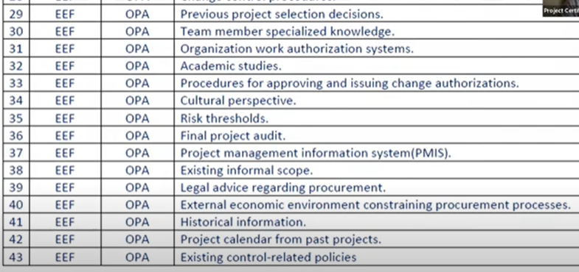
Class Exercise

Slide 16
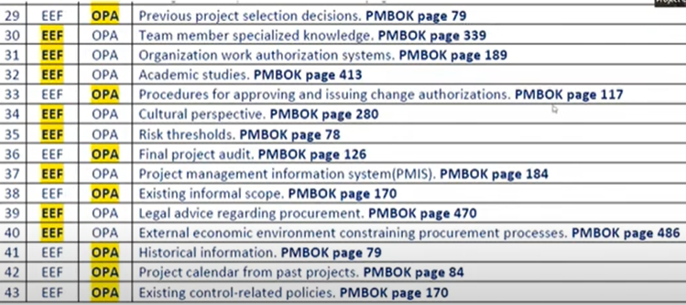
Class Exercise - Answers

Slide 17
Processes, Policies, and Procedures
Initiating and Planning:
Guidelines for tailoring the organization’s standard processes and procedures
Specific organizational standards such as policies (e.g., Policies for HR, QHSE, security, confidentiality, procurement, and environment)
Product and project life cycles, and methods and procedures (e.g., project management methods, estimation metrics, process audits, improvement targets, checklists, and standardized process definitions for use in the organization)

Slide 18
Processes, Policies, and Procedures
Initiating and Planning:
Templates (e.g., project management plans, project documents, project registers, report formats, contract templates, risk categories, risk statement templates, probability and impact definitions, probability and impact matrices, and stakeholder register templates)
Preapproved supplier lists and various types of contractual agreements (e.g., fixed-price, cost-reimbursable, and time and material contracts).

Slide 19
Processes, Policies, and Procedures
Executing, Monitoring, and Controlling:
Change control procedures, including the steps by which policies, or any project documents will be modified, and how any changes will be approved and validated;
Traceability matrices;
Financial controls procedures (e.g., time reporting, required expenditure and disbursement reviews, accounting codes, and standard contract provisions);

Slide 20
Processes, Policies, and Procedures
Executing, Monitoring, and Controlling:
Issue and defect management procedures
Resource availability control and assignment management;
Communication requirements (specific communication technology, authorized media, record retention policies, videoconferencing, and security requirements);
Procedures for approving, and issuing work authorizations;
Templates (e.g., risk register, issue log, and change log);

Slide 21
Processes, Policies, and Procedures
Executing, Monitoring, and Controlling:
Proposal evaluation and performance measurement criteria;
Product, service, or result verification and validation procedures.
Closing:
Project closure guidelines or requirements (final project audits, project evaluations, deliverable acceptance, contract closure, resource reassignment, and knowledge transfer to production and/or operations).

Slide 22
ORGANIZATIONAL KNOWLEDGE REPOSITORIES
Configuration management knowledge repositories containing the versions of software/hardware and baselines of organization standards;
Financial data repositories such as labor hours, incurred costs, budgets, and any project cost overruns;
Historical information and lessons learned (project records, project closure documentation, previous project selection decisions and risk management activities);

Slide 23
ORGANIZATIONAL KNOWLEDGE REPOSITORIES
Issue and defect management data repositories and action item results;
Data repositories for metrics to collect data on processes
Project files from previous projects (e.g., scope, cost, schedule, and performance measurement baselines, project schedule network diagrams, risk registers, and stakeholder registers).

Slide 24
ORGANIZATIONAL SYSTEMS
Projects operate within the constraints imposed by the organization through their structure and governance framework.
Project manager needs to understand where responsibility, accountability, and authority reside.
This will help him to effectively use his power, influence, competence, leadership, and capabilities to successfully complete the project.
The interaction of multiple factors creates a unique system that impacts the project operating in that system.

Slide 25
ORGANIZATIONAL SYSTEMS
Organizational system determines the power, influence, and competence of the people to act within the system.
The system factors:
Management elements,
Governance frameworks,
Organizational structure types.

Slide 26
ORGANIZATIONAL SYSTEMS
A system is a collection of various components that together can produce results not obtainable by the individual components alone.
A component is an identifiable element within the project that provides a particular function.
Interaction of various system components creates the organizational culture and capabilities.

Slide 27
ORGANIZATIONAL SYSTEMS
Systems principles:
Dynamic,
Can be optimized,
System components can be optimized,
Systems and their components cannot be optimized at the same time,
Systems are nonlinear in responsiveness (a change in the input does not produce a predictable change in the output)

Slide 28
GOVERNANCE FRAMEWORK
Governance is the framework within which authority is exercised:
Rules,
Policies,
Procedures,
Norms,
Relationships,
Systems, and
Processes.
This framework influences how:
Objectives of the organization are set and achieved,
Risk is monitored and assessed,
Performance is optimized.

Slide 29
MANAGEMENT ELEMENTS
The key functions or principles of management:
Division of work using specialized skills and availability to perform work;
Authority given to perform work;
Responsibility to perform work based on skill and experience;
Discipline of action (e.g., respect for authority, people, and rules);
Unity of command (e.g., only one person gives orders for any action);
Unity of direction (e.g., one plan and one head for a group of activities with the same objective);
General goals of the organization take precedence over individual goals;
Paid fairly for work performed;

Slide 30
FACTORS IN ORGANIZATION STRUCTURE SELECTION
Numerous factors for organizational structure:
Degree of alignment with organizational objectives,
Specialization capabilities,
Span of control, efficiency, and effectiveness,
Clear path for escalation of decisions,
Clear line and scope of authority,
Delegation capabilities,

Slide 31
FACTORS IN ORGANIZATION STRUCTURE SELECTION
Accountability assignment,
Responsibility assignment,
Adaptability of design,
Simplicity of design,
Efficiency of performance,
Cost considerations,
Physical locations
Clear communication (e.g., policies, status of work, and organization’s vision).

Slide 32
Organizational Influences
The maturity of an organization with respect to its culture, and structure can affect projects.
PMBOK describes 6 generic organizational structures. Many organizations are a blend:
  Functional: each employee has one clear superior
  Matrix: people report to multiple managers (Weak, Balanced, Strong)
  Projectized: all team members report to the Project Manager
  Composite: involves all of the above structures at various levels

Slide 33
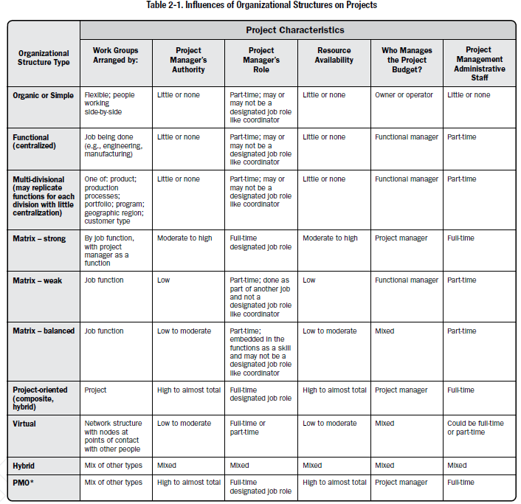

Slide 34
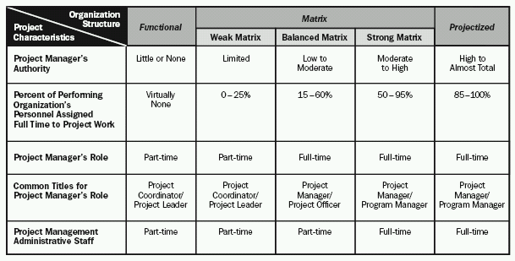
Organizational Influences
A tight matrix is not an organizational structure, but another word for collocation.

Slide 35
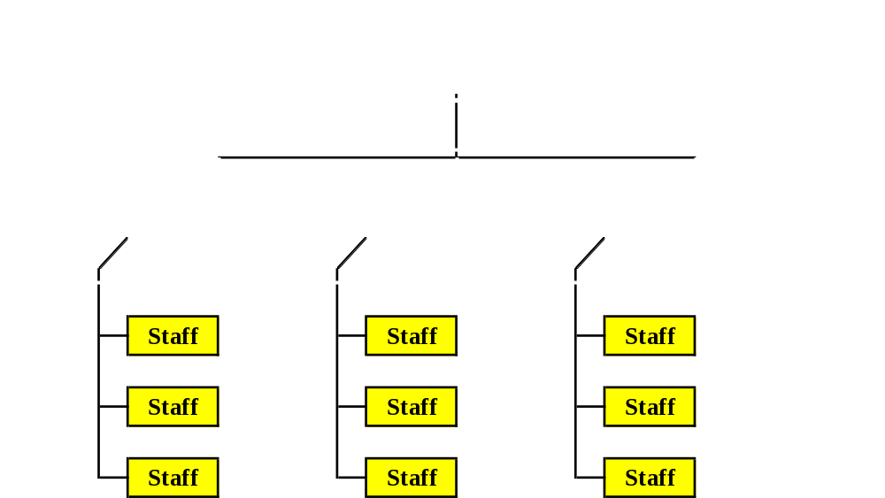
Functional Organization
Notes:
Here the control over resources is with the Functional Manager
Project Manager has to borrow the team members from the Functional Manager(s) for the project
Every employee has a clear superior
Employees automatically go back to their original positions after the project
PMI does not prefer this org type since the project manager has very little power

Slide 36
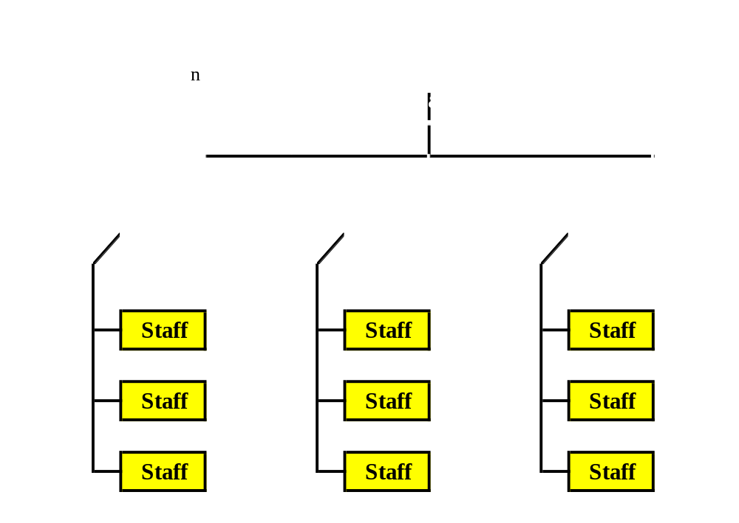
Project based organization
Notes:
Project Manager has got lots of power on using the resources.
Team members directly report to the PM
Team is dispersed after the project – not PM’s responsibility to get them assigned some where after his project

Slide 37

Matrix Organization
Notes:
Mix of a functional and projectized organization

Slide 38
Project Coordinator
Weaker than a Project Manager
Not allowed to make budget decisions or overall project decisions
May have some authority to assign / reassign some resources
Found in a weak matrix or functional org

Slide 39
Project Expeditor
Weakest among all
Staff assistant with little or no formal authority
Reports to executives who have project responsibility
Makes sure tasks are completed on time
Found in a functional organization
  A part time job in most organizations

Slide 40
PROJECT MANAGEMENT OFFICE
PMO standardizes the project-related governance, facilitates sharing of resources, methodologies, and techniques.
PMO role can range from project management support functions to the direct management of one or more projects.
Types of PMOs:
Supportive. Consultative role through templates, best practices, training, and access to information.
Serves as a project repository.
The degree of control is low.

Slide 41
PROJECT MANAGEMENT OFFICE
Controlling. support and require compliance through various means.
The degree of control is moderate.
Compliance may involve:
Adoption of project management frameworks or methodologies;
Use of specific templates, forms, and tools; and
Conformance to governance frameworks.

Slide 42
PROJECT MANAGEMENT OFFICE
Directive. Directly managing the projects.
Project managers are assigned by and report to the PMO.
The degree of control is high.
May have organization-wide responsibility.
Role in strategic alignment and delivering organizational value.
Integrates information from strategic projects and evaluates how strategic objectives are being fulfilled.

Slide 43
PROJECT MANAGEMENT OFFICE
PMO is the natural liaison between the organization’s portfolios, programs, projects, and the organizational measurement systems (e.g., balanced scorecard).
The projects supported or administered by the PMO may not be related other than by being managed together.
The specific form, function, and structure of a PMO are dependent upon the needs of the organization that it supports.

Slide 44
PROJECT MANAGEMENT OFFICE
PMO may have the authority to act as an integral stakeholder and a key decision maker of each project to keep it aligned with the business objectives.
The PMO may:
Make recommendations,
Lead knowledge transfer,
Terminate projects, and
Take other actions, as required.

Slide 45
PROJECT MANAGEMENT OFFICE
Primary function of a PMO is to support project managers:
Managing shared resources across all projects;
Coaching, mentoring, training, and oversight;
Monitoring compliance by means of project audits;
Coordinating communication across projects.

Slide 46
Contents for Lecture 4
Organizational strategy and Project Selection:
Strategic management process
Need for project portfolio Management System
Portfolio Management System; Classification of the project
Financial/ Non financial selection criteria
Applying a selection model
Managing the portfolio system

